Slide 1
Programming II
(C Programming Language)
Header Files in C
Lecture 20, Wednesday April 21, 2021
Dr. Ayman ALJARBOUH

Slide 2
Outline
Header Files in C Programming
Once-Only Headers
Include Syntax and Operation
Computed Includes
Different C Header Files

Slide 3
Header Files in C Programming
A header file is a file with extension .h containing C declarations and macro definitions to be shared between several source files
You request the use of a header file in your program by including it, with the C pre-processing directive #include
There are two types of header files:
System header files: They are header files that come with your compiler. You include them in your program to supply the definitions and declarations you need to invoke system calls and libraries
Your own header files: They contain declarations for interfaces between the source files of your program

Slide 4
Header Files in C Programming
Note that:
Including a header file produces the same results as copying the header file into each source file that needs it
Such copying would be time-consuming and error-prone
With a header file, the related declarations appear in only one place
If they need to be changed, they can be changed in one place, and programs that include the header file will automatically use the new version when next recompiled

Slide 5
Outline
Header Files in C Programming
Once-Only Headers
Include Syntax and Operation
Computed Includes
Different C Header Files

Slide 6

Include Syntax
Both user and system header files are included using the pre-processing directive #include
It has following two forms:
This form is used for system header files. It searches for a file named file in a standard list of system directories

Slide 7
Include Syntax
Both user and system header files are included using the pre-processing directive #include
It has following two forms:
This form is used for header files of your own program. It searches for a file named file in the directory containing the current file

Slide 8

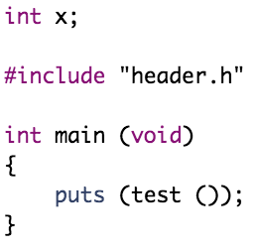
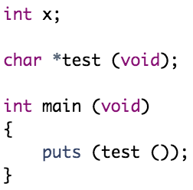
Include Operation
If you have a header file header.h as follows
and a main program called program.c that uses the header file
the compiler will see the same token stream as it would if read

Slide 9
Outline
Header Files in C Programming
Once-Only Headers
Include Syntax and Operation
Computed Includes
Different C Header Files

Slide 10
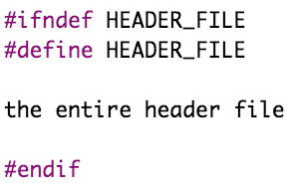
Once-Only Headers
If a header file happens to be included twice, the compiler will process its contents twice, it will certainly waste time
The standard way to prevent this is to enclose the entire real contents of the file in a conditional, like this
When the header is included again, the conditional will be false. The pre-processor will skip over the entire contents of the file, and the compiler will not see it twice

Slide 11
Outline
Header Files in C Programming
Once-Only Headers
Include Syntax and Operation
Computed Includes
Different C Header Files

Slide 12
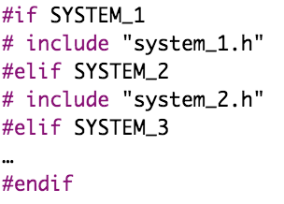
Computed Includes
Sometimes it is necessary to select one of several different header files to be included into your program
They might specify configuration parameters to be used on different sorts of operating systems, for instance
You could do this with a series of conditionals as follows:

Slide 13

Computed Includes
Sometimes it is necessary to select one of several different header files to be included into your program
They might specify configuration parameters to be used on different sorts of operating systems, for instance
Instead of writing a header name as the direct argument of #include, you simply put a macro name there instead:
SYSTEM_H will be expanded, and the pre-processor will look for system_1.h as if the #include had been written that way originally

Slide 14
Outline
Header Files in C Programming
Once-Only Headers
Include Syntax and Operation
Computed Includes
Different C Header Files

Slide 15
Different C Header Files
The following table lists some header files that are used in C:
Header File | Description
stdio.h | Standard input-output header: Used to perform input and output operations in C like scanf() and printf()
string.h | String header: Perform string manipulation operations like strlen and strcpy
conio.h | Console input-output header: Perform console input and console output operations like clrscr() to clear the screen and getch() to get the character from the keyboard
stdlib.h | Standard library header: Perform standard utility operations like dynamic memory allocation, using functions such as malloc() and calloc()
math.h | Math header: Perform mathematical operations like sqrt() and pow()
ctype.h | Character type header: Perform character type functions like isaplha() and isdigit()

Slide 16
Different C Header Files
The following table lists some header files that are used in C:
Header File | Description
time.h | Time header: Perform functions related to date and time like setdate() and getdate()
assert.h | Assertion header: It is used in program assertion functions like assert()
locale.h | Localization header: Perform localization functions like setlocale() and localeconv()
signal.h | Signal header: Perform signal handling functions like signal() and raise()
setjmp.h | Jump header: Perform jump functions
stdarg.h | Standard argument header: Perform standard argument functions like va_start and va_arg()
errno.h | Error handling header: Used to perform error handling operations like errno()

Slide 17
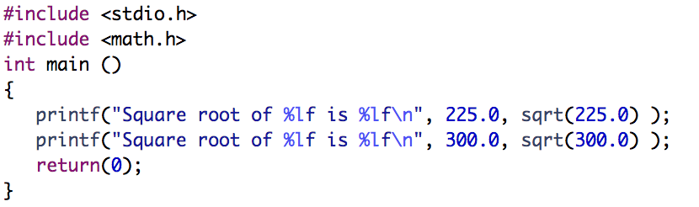
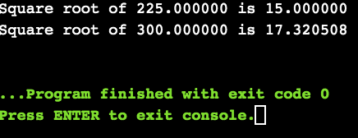
Different C Header Files
Example:

Slide 18
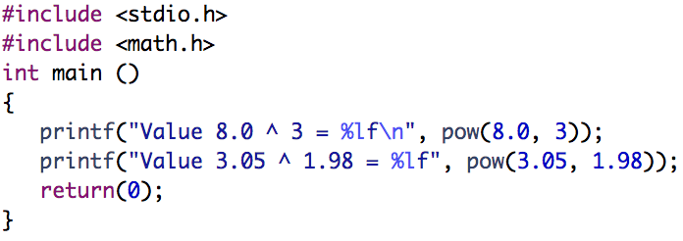
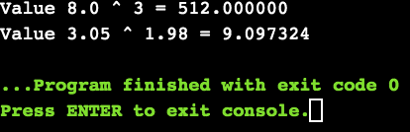
Different C Header Files
Example:

Slide 19
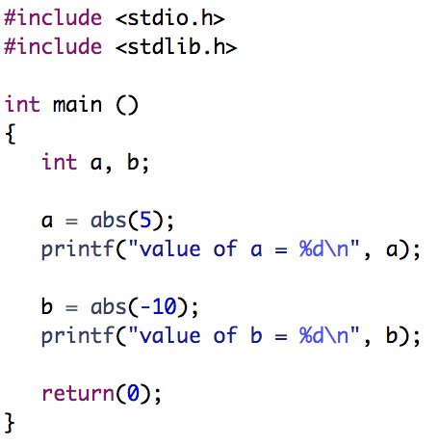
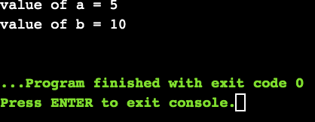
Different C Header Files
Example:

Slide 20
Practical Exercises
Write and Compile the following C programs:
Program 1:

Slide 21
Practical Exercises
Write and Compile the following C programs:
Program 2:

Slide 22
Practical Exercises
Write and Compile the following C programs:
Program 3:

